Slide 1


Vehicle Control System Implementation Using CAN Protocol
P. A. COLLEGE OF ENGINEERING AND TECHNOLOGY.
Accredited by NAAC with ‘A’ grade.
DEPARTMENT OF ELECTRONICS AND COMMUNICATION ENGINEERING.
Accredited by NBA
Presented by,
R.P.ANUSUBHASHINI (721714106008)
R.CAROLENE PREM LEELA(721714106018)
M.KIRUTHIKA(721714106049)
Guided by,
Mr. R. VISHNU VARDHAN, Assistant Professor,
Department of ECE.

Slide 2
OBJECTIVE
To Implement the control system for vehicle using CAN protocol with ultra low power consuming TI controller and low cost Micro Chip Transceiver.

Slide 3
METHODOLOGY
Texas Instrument’s MSP-EXP430G2553LP – Ultra low power consumption controller.
MCP2551 Transceiver.

Slide 4
EXISTING METHOD
ANALOG DISPLAY
ECU
(ARM,SPI)
CONTROLS

Slide 5
PROPOSED METHOD
ANALOG DISPLAY
ECU
(MSP430,CAN)
CONTROLS

Slide 6
LITERATURE SURVEY
No. | Title | Year | Methods Used | Advantages | Disadvantages
1. | A control area network for high speed communication. | 1993 | Barkeley Lower Extremity Exoskeleton (BLEEX) method. | Reduce the power consumption | Complex non-liner control system
2. | A CAN based microchip technology. | 1999 | Digital signal integrated CAN | High speed, reliable communication, low cost | To added external controller

Slide 7
LITERATURE SURVEY (cond.,)
No. | Title | Year | Methods Used | Advantages | Disadvantages
3. | Automatic control system. | 2003 | PID using controller | High speed | Electrical noise
4. | Trends in Automotive Communication Systems | 2005 | Vehicle speed estimated by the engine controller or by wheel rotation sensors | More flexible, dynamic part communication cycle | low computational power, small amount of memory

Slide 8
LITERATURE SURVEY (cond.,)
No. | Title | Year | Methods Used | Advantages | Disadvantages
5. | Calculating CAN message response times. | 2006 | A station on a CAN bus is able to receive a message based on the message identifier. | Immediate re-transmission | Worst –case response of a given message.
6. | Embedded system design for automotive application | 2007 | Automatically map a set of tasks onto the platform, guaranteeing the correct functionality and timing with optimal resource utilization. | high-speed, highly deterministic communication. reliability, ﬂexibility, and extensibility | complex subsystems, high distribution, complexity, and interoperability.

Slide 9
LITERATURE SURVEY (cond.,)
No. | Title | Year | Methods Used | Advantages | Disadvantages
7. | A CAN bus transceiver behavioral model for network design and simulation. | 2009 | Peer-peer network method | Automatic re-transmission | Network is very noisy
8. | Design of embedded remote temperature monitoring based on advanced RISC machine | 2010 | Flash-beep message delivered on android user handset | Inexpensive sensing, monitoring and control capabilities. | Complex software

Slide 10
LITERATURE SURVEY (cond.,)
No. | Title | Year | Methods Used | Advantages | Disadvantages
9. | Vehicle control system implementation Using CAN protocol | 2013 | Using ARM as the main controller. | Low cost, high –performance, high speed. | Power consumption.
10. | A CAN protocol based embedded system to avoid rear-end collision of vehicle | 2015 | IR communication to communicate with the trailing vehicle to warn the driver and take proper control action to avoid the rear-end collision. | Lower cost, cheaply available. | Difficult to implement.

Slide 11
BLOCK DIAGRAM FOR VEHICLE CONTROL SYSTEM IMPLEMENTATION USING CAN PROTOCOL
Wiper control
CAN Bus
Fan and buzzer
Fuel measurement
MSP430 controller
Rain water sensor
Temperature
measurement
LCD display

Slide 12
FLOW CHART FOR VEHICLE CONTROL SYSTEM IMPLEMENTATION USING CAN PROTOCOL
START
LCD MODULE
NODE CREATION
SENSOR INTERFACE
CAN MODULE
STOP

Slide 13
FEATURES OF MSP430G2553
Low Supply-Voltage Range: 1.8 V to 3.6 V
Ultra-Low Power Consumption.
16-Bit RISC Architecture, 62.5-ns Instruction (A/D) Conversion Cycle Time
10-Bit 200-ksps Analog-to-Digital (A/D).
Two 16-Bit Timer A.

Slide 14
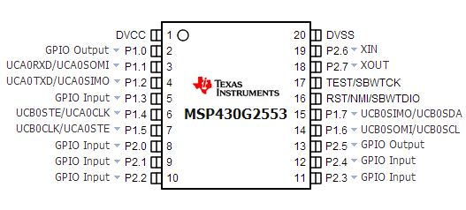
MSP430G2553 PIN DIAGRAM

Slide 15
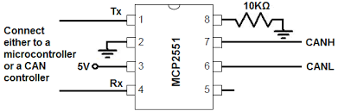
MCP2551 PIN DIAGRAM

Slide 16
CAN TRANSCEIVER
The CAN bus was a multi-master, message broadcast system.
It specifies a maximum signaling rate of 1 megabit per second (mbps).
CAN is an serial communications bus.
Developed for the automotive industry to replace the complex wiring harness with a two-wire bus.
The specification calls for high immunity to electrical interference.

Slide 17
FEATURES OF CAN TRANSCEIVER
Supports 1 Mb/s operation.
Suitable for 12V and 24V systems.
Low current standby operation.
Protection against high-voltage transients.
Automatic thermal shutdown protection.
Up to 112 nodes can be connected.
High-noise immunity due to differential bus implementation.

Slide 18
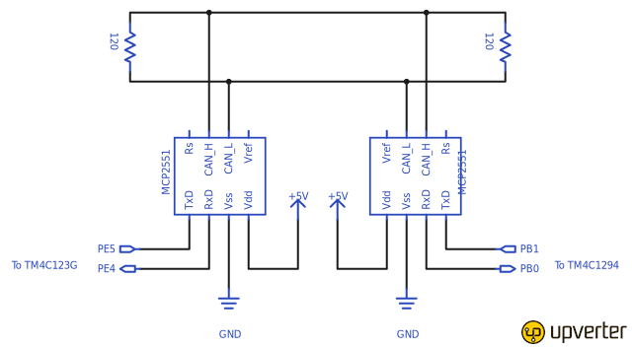
CAN MASTER-SLAVE INTERFACE

Slide 19
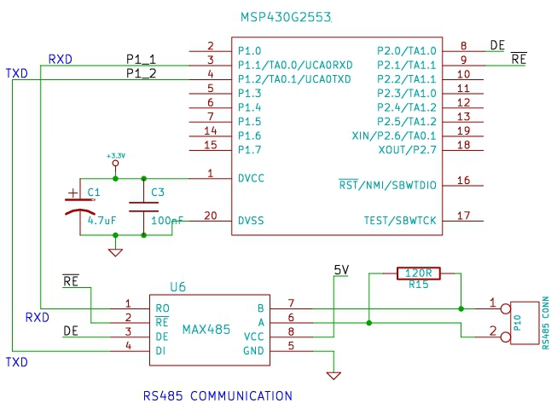
ALTERNATE..

Slide 20
ENERGIA
Simple & easy-to-use code editor & compiler.
Support for various TI embedded devices (MSP430, TM4C, CC3200, C2000, etc)
It is an open source.
Higher level libraries are also available.
It is a portable framework/abstraction layer it can be used in other popular IDEs.

Slide 21
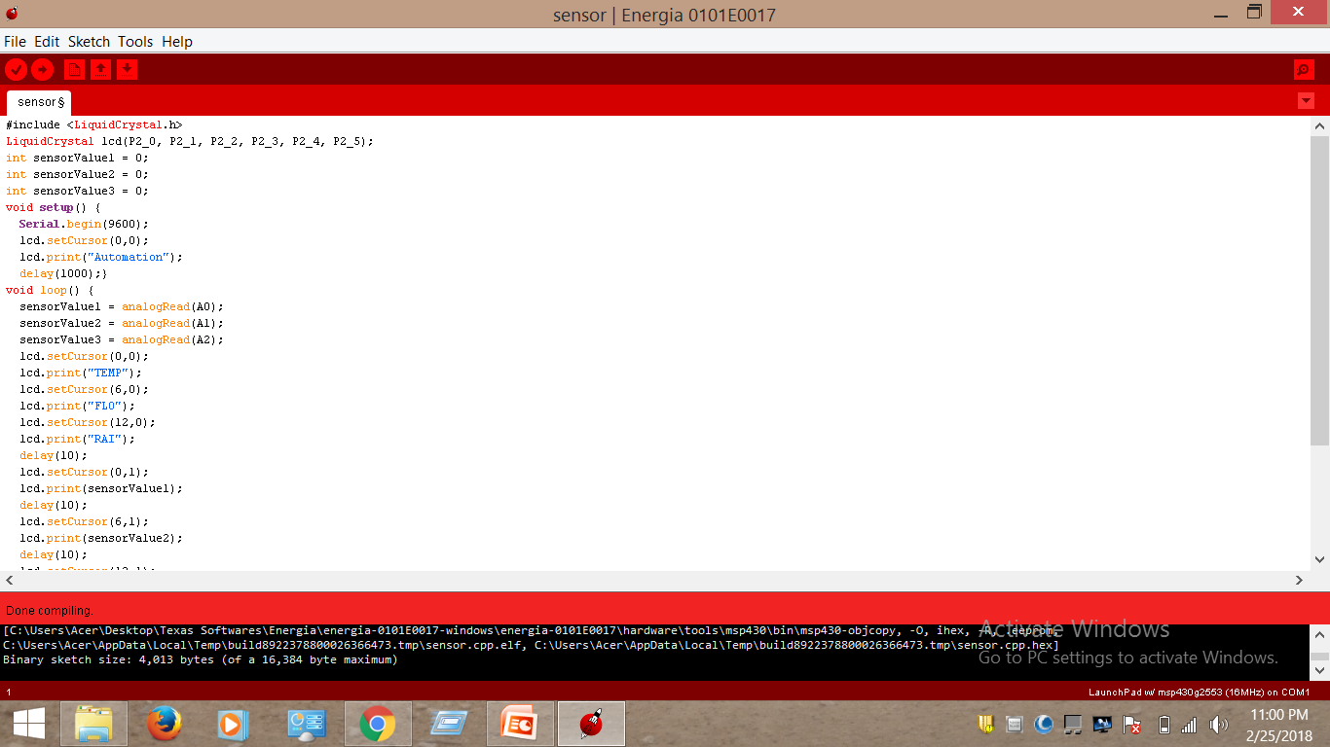
ENERGIA PROGRAMMING

Slide 22
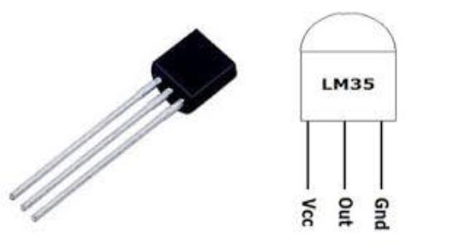
SENSORS
TEMPERATURE SENSOR:
The LM35 is used to measure temperature.
It measures temperature more accurately than a using a thermistor.
The LM35 generates a higher output voltage than thermocouples.
It not require any amplifier
circuit.

Slide 23
SENSORS
RAIN WATER LEVEL SENSOR:
To sense the rain water level in the wiper.
FUEL LEVEL SENSOR:
To sense the fuel level of the automotive.

Slide 24
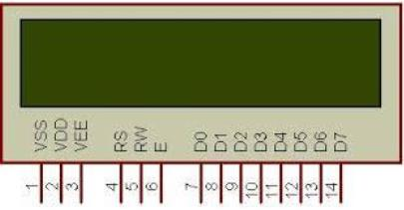
LCD DISPLAY
LCD (Liquid Crystal Display) screen is an electronic display module.
These modules are preferred over seven segments and other multi segment LEDs.
Advantages:
LCDs are economical;
easily programmable;

Slide 25
OPERATION
There are master and slave modules in this vehicle control system implementation. In master module, sensor has been interfaced. Analog sensors like Temperature sensor and Rain water sensor which are connected to ADC ports,
Where the Analog values are converted into digital.MSP430G2553 has a10 bit ADC, so the maximum precision is 1023 as digital value .Digital sensor like Fuel level sensor is used.

Slide 26
OPERATION(cond.,)
These values from different sensors are transmitted through CAN frames using CAN transceiver MCP2551 which supports 1Mbps operation. One CAN transceiver at the transmitter end, which is on Master controller and other CAN transceiver at the receiver end, which is on Slave controller. These CAN transceivers are interconnected by using CAN bus.
In slave module, the MSP430G2553 controller is interfaced with MAX232 which is a dual transmitter / dual receiver that converts signals from a TIA-232 (RS-232) serial port to signals suitable for use in TTL-compatible digital logic circuits. It is an alternate serial port output of the sensor values.

Slide 27
OPERATION(cond.,)
The serial monitor in ENERGIA can display the digital values of the sensors, provided com port of the USB and device should be similar, Baud rate of the controller terminal should be 9600Hz and tool selection should be made. Through receiver which is slave module the data’s are displayed in serial monitor.

Slide 28
POWER REPORT
Current(uA)
Tpro(ms)

Slide 29
BATTERY LIFE PERIOD
Days
Tpro(ms)

Slide 30
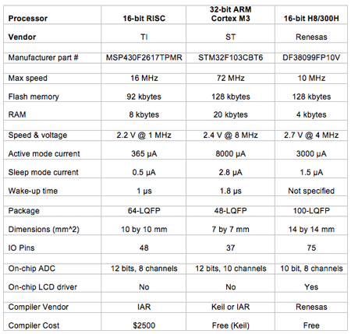
COMPARISON OF PROCESSORS

Slide 31
APPLICATION
Automotive system applications.
Ultra low power controller applications.
Fastest data transmission.

Slide 32
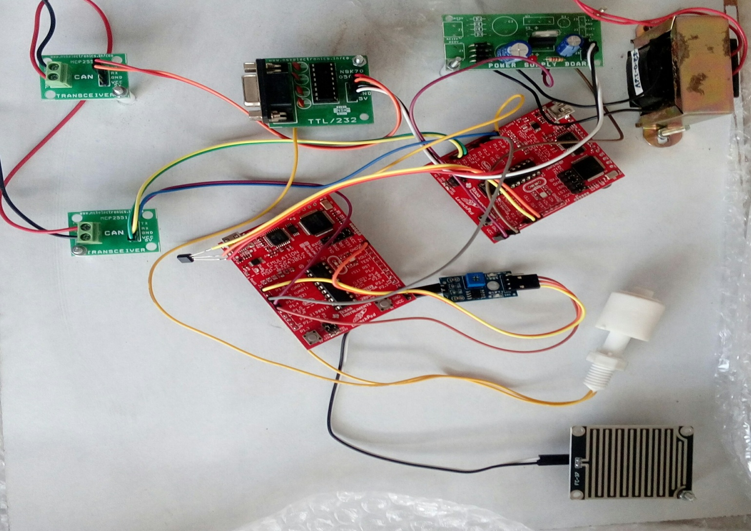
HARDWARE SETUP

Slide 33
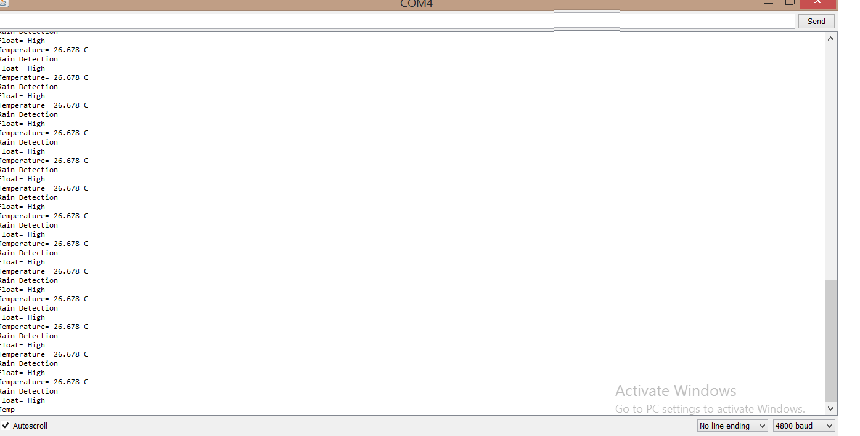
OUTPUT

Slide 34
CONCLUSION
Vehicle control system implementation has been executed and verified using MSP430G2553 Launch pad.

Slide 35
REFERENCES
Vijayalakshmi,S. “ Vehicle control system implementation Using CAN protocol”. IJAREEIE, Volume 2, Issue 6, June 2013.
Kumar, M. A.Verma, and A. Srividya, Response-Time “Modeling of Controller Area Network (CAN). Distributed Computing and Networking, Lecture Notes in Computer Science Volume 5408, p 163-174, 2009.
Li, M., Design of Embedded Remote Temperature Monitoring System based on Advanced RISC Machine. Electrotechnics Electric, 06, p. 273, 2009.
Prodanov, W., M. Valle, and R. Buzas, A controller area network bus transceiver behavioral model for network design and simulation. IEEE Transactions on Industrial Electronics, 56(9): p. 3762-377, 2009.
Wilfried Voss, A comprehensive guide to controller area network, Copperhill Media Corporation, 2005-2008.
Tindell, K., A. Burns, and A.J. Wellings, Calculating controller area network (CAN) message response times. Control Engineering Practice, 3(8): p. 1163-1169, 2005.
Benjamin C Kuo, M. Farid Golnaraghi,Automatic Control systems, Eight edition, John wiley & sons., Inc 2003.
Pazul, “Controller Area Network (CAN) Basics”, Microchip technology Inc., AN713, May 1999.
ISO (1993). Road Vehicles: Interchange of Digital Information: Controller Area Network (CAN) for High Speed Communication. ISO 11898:1993.
B.Gmbh, “CAN specifications” vol 1 Version 2.0, 1991.

Slide 36
THANK YOU

